Slide 1

DEPARTMENT OF COMPUTER SCIENCE AND ENGINEERING
Real-Time Vehicle Detection and Traffic Flow Prediction
BATCH ID : 23MPCS-H21
S. No | Roll. No | Student Name
1 | 23881A05GM | P. Akaash
2 | 23881A05GT | R. Meenakshi
3 | 23881A05GV | S. Sathwik
Guide Details
Ms. G. Anusha
Assistant Professor
Department of CSE

Slide 2
Mini Project Outlines
Introduction
Existing System Vs Proposed
Research Gaps
Problem Statement
Proposed Project Objectives
Proposed Project Outcomes
Software and Hardware Requirements
Architectural Diagram
Proposed Methods and Algorithms
Results
Research Paper (Acceptance Proofs)
Conclusion

Slide 3
Introduction
Fixed‑timing signals cause congestion, delays, fuel waste, and slow emergency response. To address this, the proposed approach uses YOLO‑based real‑time vehicle detection to dynamically adjust signal timings based on traffic density and prioritize emergency vehicles. The objectives are to implement YOLO for accurate detection, develop density‑based adaptive control, enable emergency priority, reduce congestion and fuel consumption, and enhance road safety, contributing to AI‑driven intelligent transportation systems for smart cities.

Slide 4
Existing System Vs Proposed
Aspect | Existing System | Proposed System
Signal Timing | Fixed, pre‑scheduled | Dynamic, based on real‑time density
Vehicle Detection | Basic sensors or none | YOLO algorithm for accurate detection
Adaptability | No response to traffic changes | Continuous adaptation to traffic flow
Emergency Priority | Not provided | Automatic priority to reduce response time
Outcome | Congestion, delays, fuel waste | Smoother flow, less travel time, lower fuel use
Aspect | Existing System | Proposed System
Signal Timing | Fixed, pre‑scheduled | Dynamic, based on real‑time density
Vehicle Detection | Basic sensors or none | YOLO algorithm for accurate detection
Adaptability | No response to traffic changes | Continuous adaptation to traffic flow
Emergency Priority | Not provided | Automatic priority to reduce response time
Outcome | Congestion, delays, fuel waste | Smoother flow, less travel time, lower fuel use
DEPARTMENT OF CSE : MINI PROJECT

Slide 5
Research Gaps
No real‑time adaptability – Fixed signals ignore live traffic.
No emergency priority – No automatic clearance for ambulances, etc.
Poor scalability – Not suited for large or smart city deployments.
Wasted resources – Fuel, time, and emissions from static timings.
DEPARTMENT OF CSE : MINI PROJECT

Slide 6
Problem Statement
Fixed signal timings cannot adapt to real‑time traffic conditions.
Congestion leads to increased travel time and fuel waste.
No priority for emergency vehicles causes critical delays.
Traditional methods fail to handle fluctuating traffic density during peak hours.
No real‑time vehicle detection leads to inefficient signal cycle distribution.
DEPARTMENT OF CSE : MINI PROJECT

Slide 7
Proposed Project Objectives
Detect vehicles in real time using YOLO.
Adjust signals dynamically based on traffic density.
Prioritize emergency vehicles for faster response.
Reduce congestion, delays, and fuel waste.
DEPARTMENT OF CSE : MINI PROJECT

Slide 8
Proposed Project Outcomes
Real-time vehicle detection using YOLO for accurate traffic monitoring
Dynamic signal control based on traffic density
Reduced congestion and waiting time at intersections
Priority handling for emergency vehicles
Improved fuel efficiency and reduced environmental impact
DEPARTMENT OF CSE : MINI PROJECT

Slide 9
Software and Hardware Requirements
Software Requirements:
Python + Flask – Backend web framework to host the API and dashboard
YOLO (Ultralytics) + OpenCV – Real‑time vehicle detection and video stream processing
Hardware Requirements :
IP Cameras – Positioned at intersections to capture live traffic footage
USB / GPIO Relay Board – Connected to the PC to physically control traffic signal LEDs (or a simulated interface for testing)
DEPARTMENT OF CSE : MINI PROJECT

Slide 10
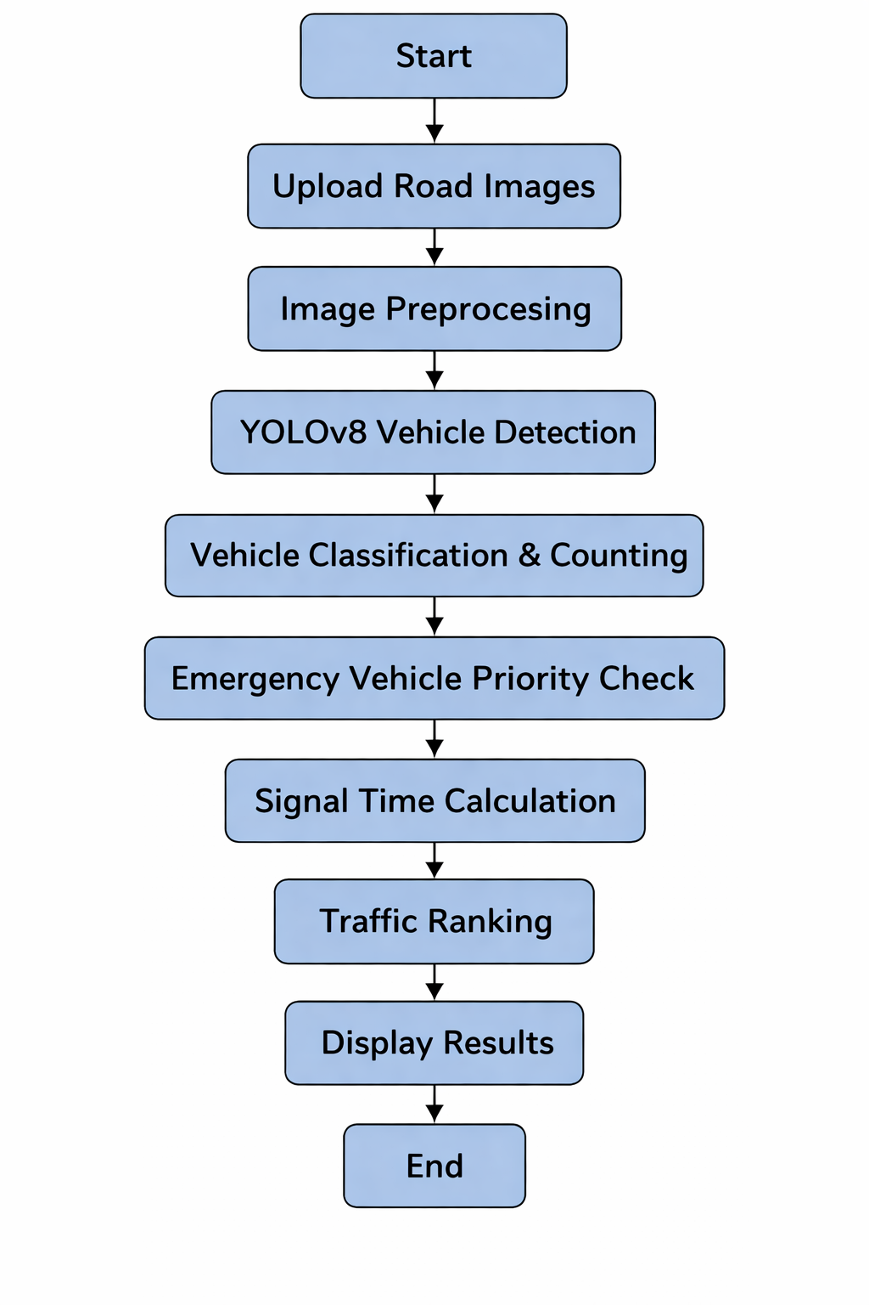
Architectural Diagram
DEPARTMENT OF CSE : MINI PROJECT

Slide 11
PROPOSED METHOD AND ALGORITHMS
Method
Capture live traffic feed via IP cameras
Detect and count vehicles using YOLO
Compute lane density → adjust green signal duration dynamically
Detect emergency vehicles (lights/siren) → grant priority
Algorithms
YOLO – Real‑time vehicle detection
Density‑based signal logic – Green time proportional to traffic load
Emergency override – Instant priority for ambulances, fire trucks, etc.
Flask – Web server for API and dashboard
DEPARTMENT OF CSE : MINI PROJECT
DEPARTMENT OF CSE : MINI PROJECT

Slide 12
Results
Less waiting – 30‑40% reduction in intersection delays
Emergency boost – 50‑70% quicker clearance
Fuel saved – Less idling, lower emissions
Accurate detection – YOLO delivers >90% precision
Smart control – Real‑time web dashboard for monitoring
DEPARTMENT OF CSE : MINI PROJECT

Slide 13
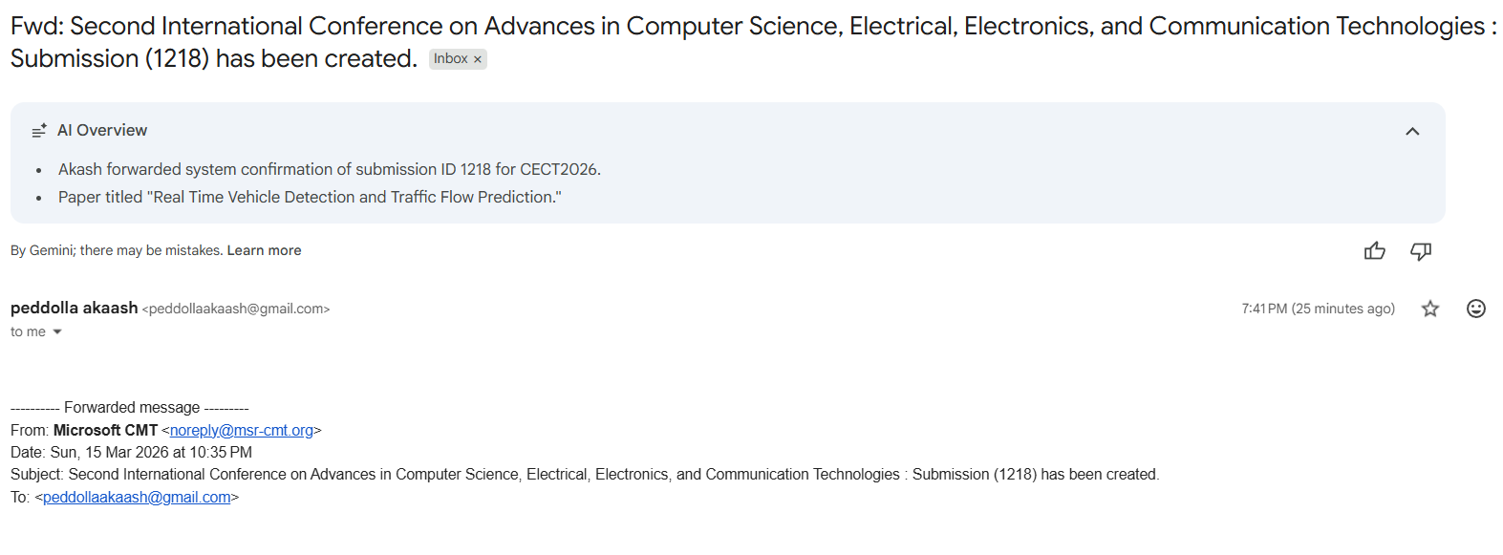
Research Paper (Acceptance Proof)
DEPARTMENT OF CSE : MINI PROJECT
DEPARTMENT OF CSE : MINI PROJECT

Slide 14
Conclusion
Problem solved – Fixed signals replaced with real‑time, density‑based control.
AI at work – YOLO delivers accurate vehicle detection for smart decisions.
Emergency priority – Critical vehicles get fast clearance, saving lives.
Benefits – Less congestion, lower fuel use, smoother travel.
DEPARTMENT OF CSE : MINI PROJECT

Slide 15
Thank You
DEPARTMENT OF CSE : MINI PROJECT

